Slide 1
Transportation &
Logistics Systems
Session 5
Facility Planning,
Course Wrap-up & Evaluation
February 5, 2019

Slide 2
Announcements
HW 3 Graded
Average: 146.6
Median: 148
SD: 2.8
HW 4 due now
Final exam to be available 12:01 AM Thursday

Slide 3
Lecture Outline
Transportation Wrap-up
Case: Applichem
Intro to Facility Planning
Facility Design Framework & Models
Course Summary & Wrap-up

Slide 4
Demand Allocation Model with Fixed Costs
Plant | Production/Transportation Cost to Market |  |  |  |  |  | Capacity
 | Atlanta | Boston | Chicago | Denver | Omaha | Portland
Baltimore | 1675 | 400 | 685 | 1630 | 1160 | 2800 | 18
Chayenne | 1460 | 1940 | 970 | 100 | 495 | 1200 | 24
Salt Lake | 1925 | 2400 | 1425 | 500 | 950 | 800 | 27
Memphis | 380 | 1355 | 543 | 1045 | 665 | 2321 | 22
Wichita | 922 | 1646 | 700 | 508 | 311 | 1797 | 31
Demand/Mo | 10 | 8 | 14 | 6 | 7 | 11
Fixed Cost
7650
3500
5000
4100
2200
What is the optimal SC configuration?

Slide 5
New Concept: 0-1 variable
0-1 (binary) variables model “go/no-go” decisions
  When does it make sense to use one?
Need to be specified as “bin” (for binary) in solver
Need to account for such actions logically
  Whether we incur a fixed cost for a facility
  Cannot have shipment out of a closed facility/plant
  Whether to select a specific route in a routing problem

Slide 6
Transportation Modes
Let us look at slides from the last class…

Slide 7
Lecture Outline
Transportation Wrap-up
Case: Applichem
Intro to Facility Planning
Facility Design Framework & Models
Course Summary & Wrap-up

Slide 8
Applichem: Overview
Applichem
  Four manufacturing plants
  Old technology
  Release-ease is a commodity product
  Thin margin
  Potential problems at the Gary plant
Competition
  Leading market shares
  Sole supplier in Japan
  Low technology barrier for competitor entry

Slide 9
Applichem: Issues
What has Joe Spadaro learned from the
multi-plant productivity Study?
2. Should the Gary plant be closed?
3. Should you have excess capacity in a network?

Slide 10
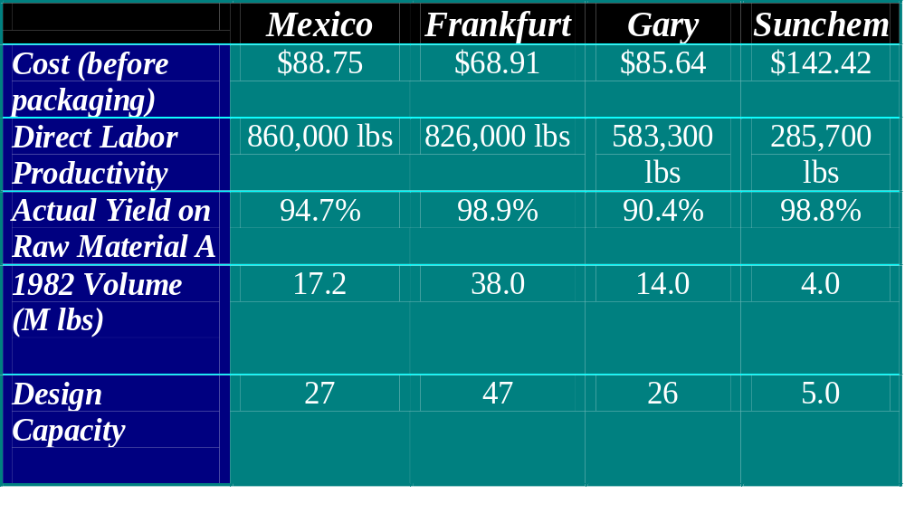
The Productivity Study

Slide 11
Applichem: Issues
What has Joe Spadaro learned from the
multi-plant productivity Study?
2. Should the Gary plant be closed?
3. Should you have excess capacity in a network?

Slide 12
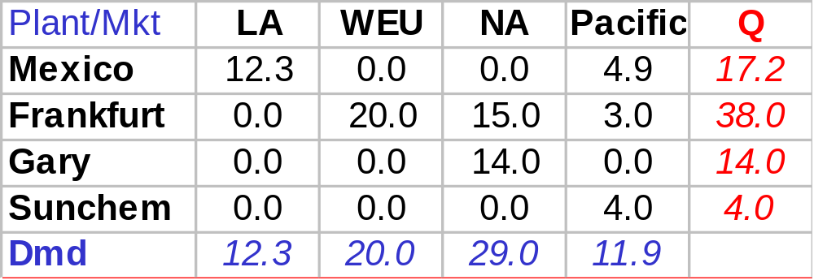
Applichem: Current SC (Demand Allocation)
Derived from p. 3 of Case
Notes:
12

Slide 13
Applichem: Current SC (Demand Allocation)
Cap.
Plant
Mkt
Demand
27
Mexico
LA
12.3
47
Frankfurt
WEU
20
26
Gary
NA
29
5
Sunchem
Pacific
11.9
Annual Cost = $67.7M
Notes:
13

Slide 14
Applichem: Best SC Network
Market/ Plant |  |  |  |  | Shipment from Plant | Capacity
 | LA | WEU | NA | Pacific
Mexico | 12.3 | 0.0 | 13.9 | 0.0 | 26.2 | 27
Frankfurt | 0.0 | 20.0 | 15.1 | 11.9 | 47.0 | 47
Gary | 0.0 | 0.0 | 0.0 | 0.0 | 0.0 | 26
Sunchem | 0.0 | 0.0 | 0.0 | 0.0 | 0.0 | 5
Shipment to Market | 12.3 | 20.0 | 29.0 | 11.9
Gary, Sunchem closed!
Cost = $63.86M
Additional Issues
More strategic issues can over-ride this decision
Frankfurt plant has 100% utilization
Notes:
14

Slide 15
Applichem: Issues
What has Joe Spadaro learned from the
multi-plant productivity Study?
2. Should the Gary plant be closed?
3. Should you have excess capacity in a network?

Slide 16
Excess Capacity Issues
Some amount of excess capacity is useful
  Hedge against macro-economic risks
  Hedge against disruption
Potential problems if utilization is 100%
How much excess capacity
  Well, hard to say…
Notes:
16

Slide 17
Lecture Outline
Transportation Wrap-up
Case: Applichem
Intro to Facility Planning
Facility Design Framework & Models
Course Summary & Wrap-up

Slide 18
The SC Network
The Supply Chain Network consists of:
Facilities
  Vendors,
  Manufacturing Centers,
  Warehouse/ Distribution Centers, and
  Customers
Raw materials and finished products that flow between the facilities

Slide 19
Network Design
The Key Issues:
1. Number of plants, warehouses
2. Location of each plant and warehouse
3. Capacity of each plant, warehouse
4. Allocation of products to plants and warehouses
5. Allocation of customers to each warehouse

Slide 20
Network Design
The objective is to balance service level against
  Production/ purchasing costs
  Inventory carrying costs
  Facility costs (storage, handling and fixed costs)
  Transportation costs

Slide 21
Costs and Number of Facilities
Costs
Total Cost
% Serviced Within Promised Time
Inventory
Facility costs
Transportation
Labor
Number of facilities
Notes:
21
Notes:

Slide 22
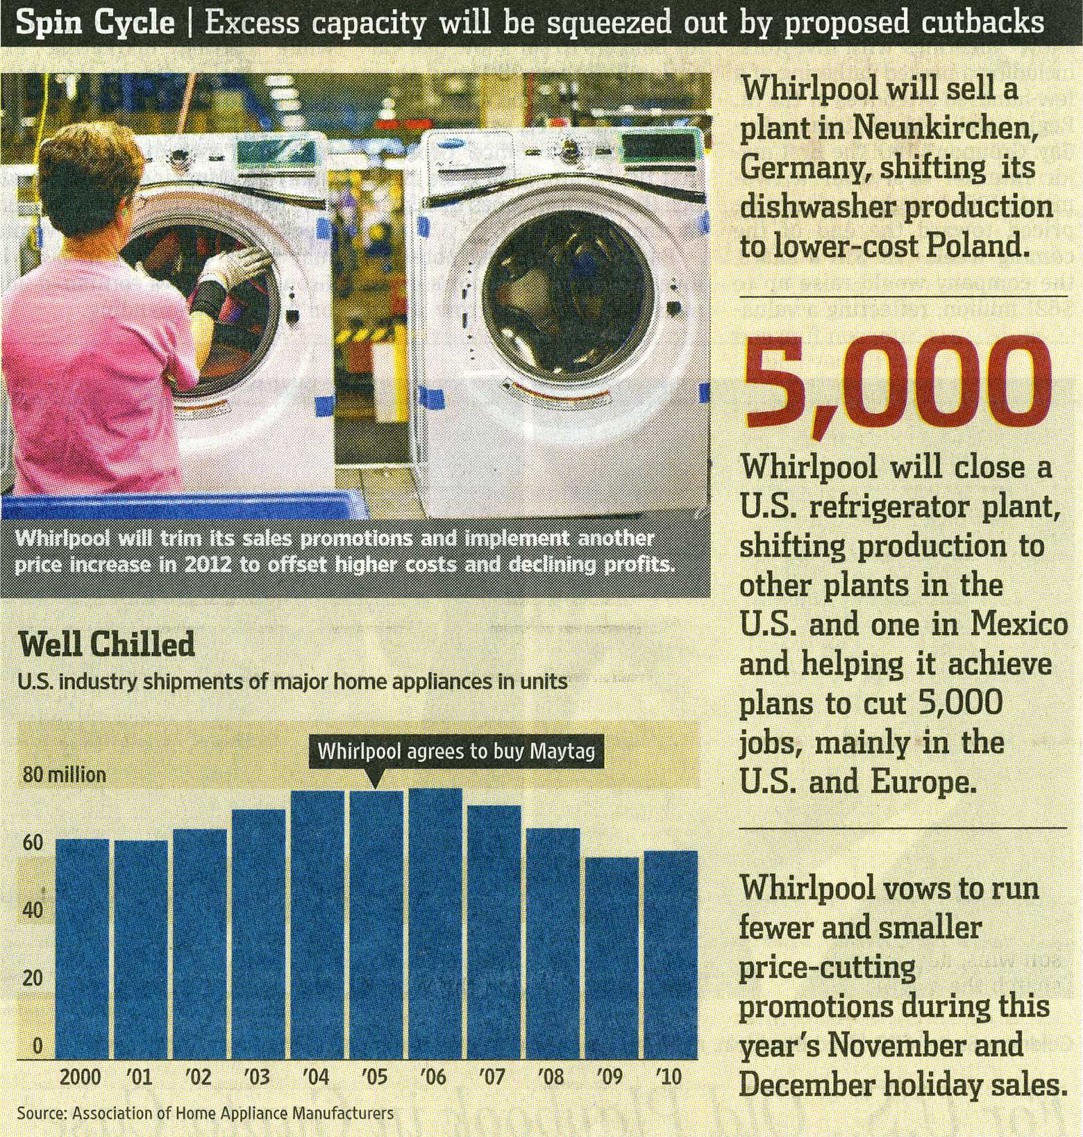
The Wall Street Journal
October 29, 2011

Slide 23
Lecture Outline
Transportation Wrap-up
Case: Applichem
Intro to Facility Planning
Facility Design Framework & Models
Course Summary & Wrap-up

Slide 24
Factors Influencing Network Design Decisions
Strategic
Technological
Macroeconomic
Political
Infrastructure
Competitive
Logistics and facility costs

Slide 25
A Framework for Site Location
Competitive STRATEGY
GLOBAL COMPETITION
PHASE I
Supply Chain
Strategy
INTERNAL CONSTRAINTS
Capital, growth strategy,
existing network
TARIFFS AND TAX
INCENTIVES
PRODUCTION TECHNOLOGIES
Cost, Scale/Scope impact,
Support required, flexibility
REGIONAL DEMAND
Size, growth, homogeneity,
local specifications
PHASE II
Regional Facility
Configuration
COMPETITIVE
ENVIRONMENT
POLITICAL, EXCHANGE
RATE AND DEMAND RISK
PHASE III
Desirable Sites
AVAILABLE
INFRASTRUCTURE
PRODUCTION METHODS
Skill needs, response time
FACTOR COSTS
Labor, materials, site specific
PHASE IV
Location Choices
LOGISTICS COSTS
Transport, inventory, coordination
Notes:
25
Notes:

Slide 26
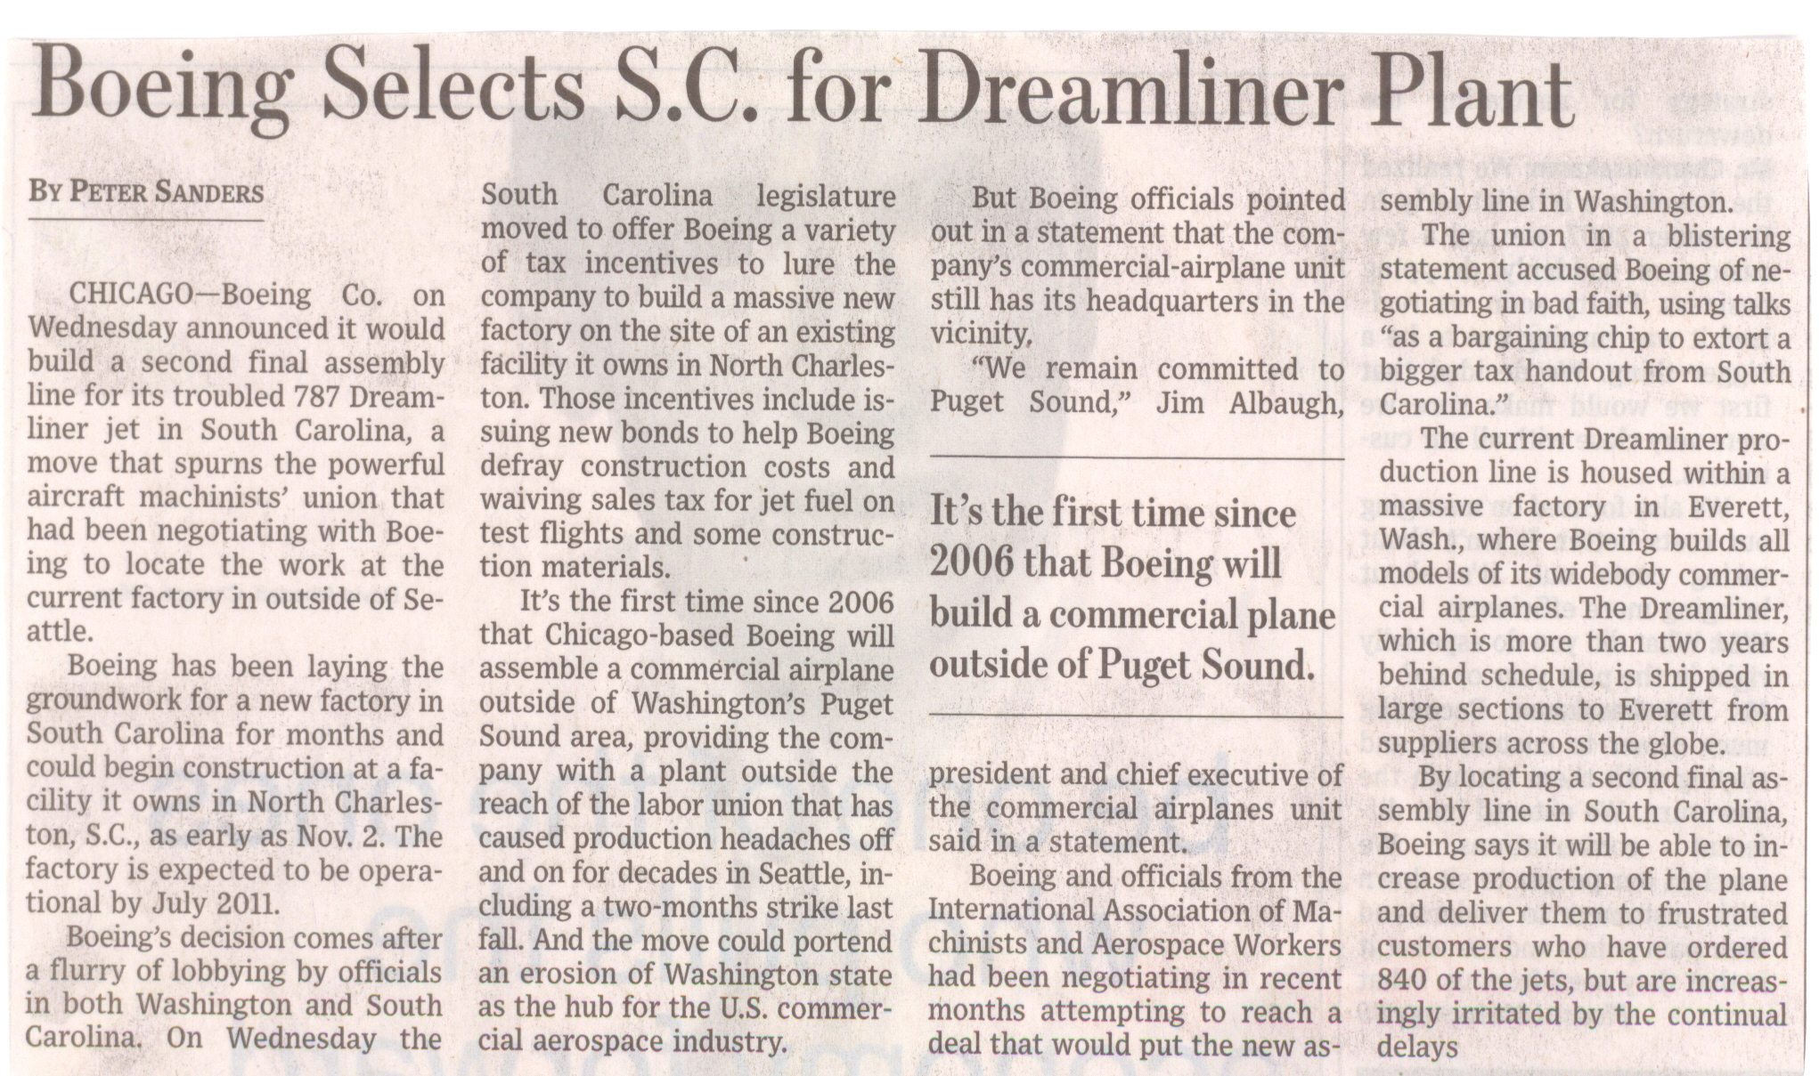
Example…
The Wall Street Journal, October 29, 2009

Slide 27
Example…
The Wall Street Journal
October 29, 2009
Hourly wage for assembler mechanics after six years on the job:
$39 in WA (unionized)
$23 in SC (non-union)
Source: PBS News Hour, October 30, 2016.
http://www.pbs.org/newshour/episode/pbs-newshour-weekend-full-episode-oct-30-2016/

Slide 28
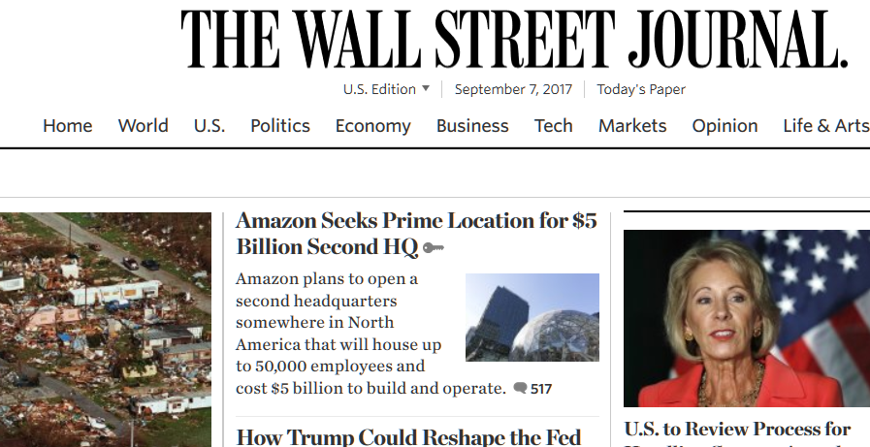
In soliciting bids for the project, which Amazon calls HQ2, the company is
prioritizing metropolitan areas with more than a million people that are
within 45 minutes of an international airport and near a strong university system.
Incentives from state and local governments will be “significant factors”
in its decision, Amazon said.
Source: The Wall Street Journal Online, September 7, 2017

Slide 29
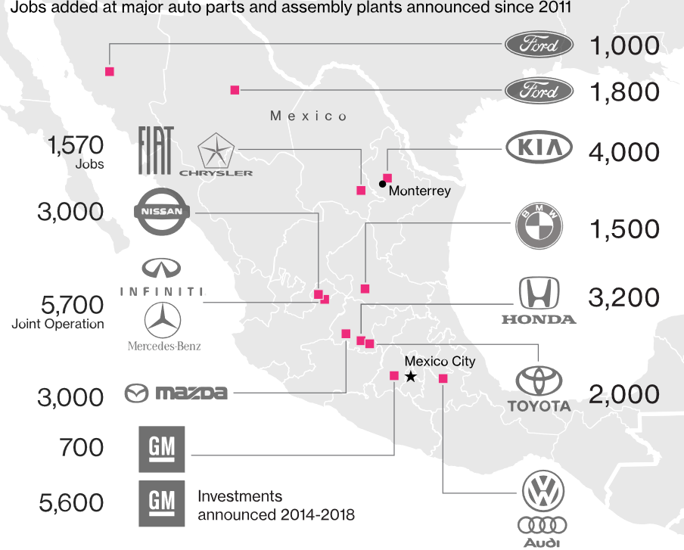
Auto Manufacturing in Mexico (1 of 3)
Source: https://www.bloomberg.com/graphics/2017-trump-mexico-auto-jobs/

Slide 30
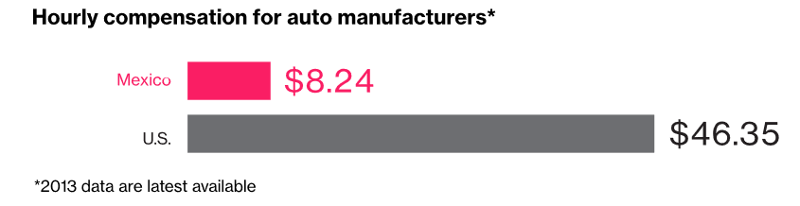
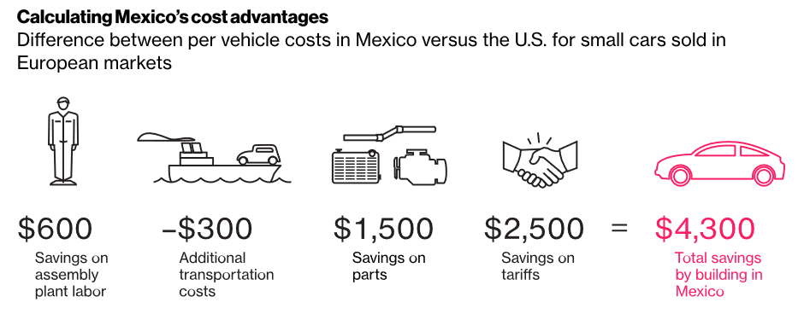
Auto Manufacturing in Mexico (2 of 3)
Mid-size sedan, made in Mexico vs USA, sold in EU for $25,000
Source: https://www.bloomberg.com/graphics/2017-trump-mexico-auto-jobs/

Slide 31
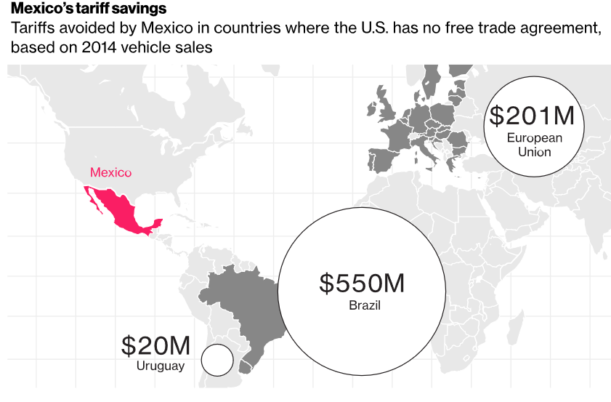
Auto Manufacturing in Mexico (3 of 3)
Mid-size sedan, made in Mexico, sold elsewhere in the world
Tariffs avoided by automakers
by manufacturing in Mexico in
2014: $770M
$2500 savings per car sold in
the EU, made in Mexico
28% of Mexican auto exports
will be outside N. America in
2018
Source: https://www.bloomberg.com/graphics/2017-trump-mexico-auto-jobs/

Slide 32
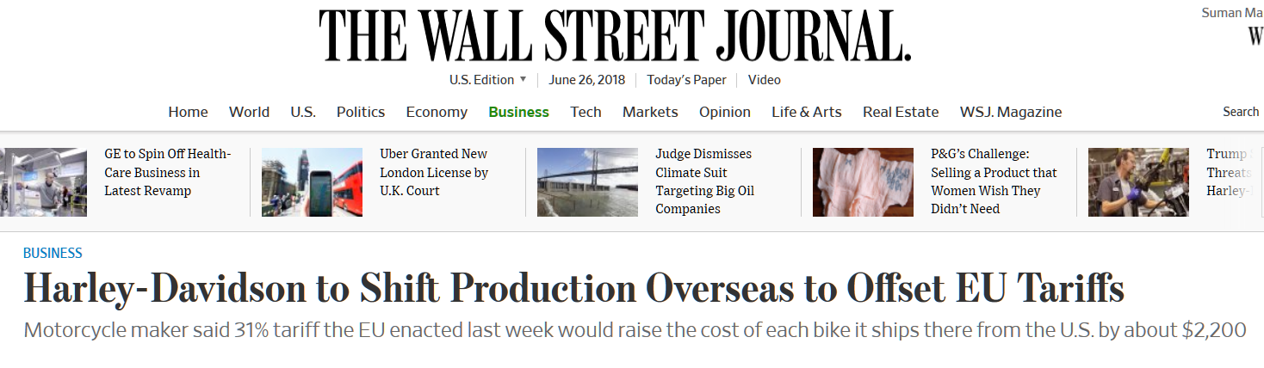
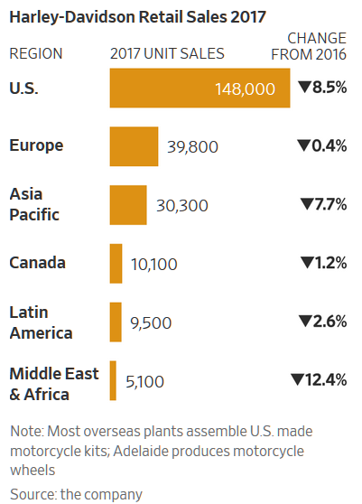
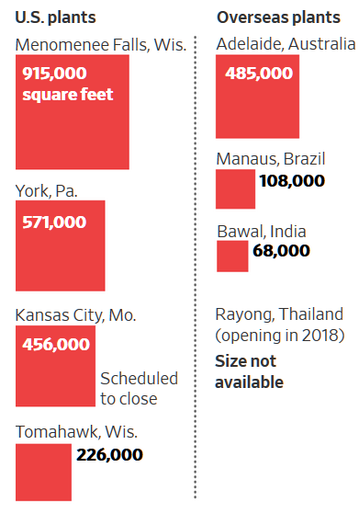
Harley-Davidson (1 of 2)
Source: The Wall Street Journal, June 26, 2018

Slide 33
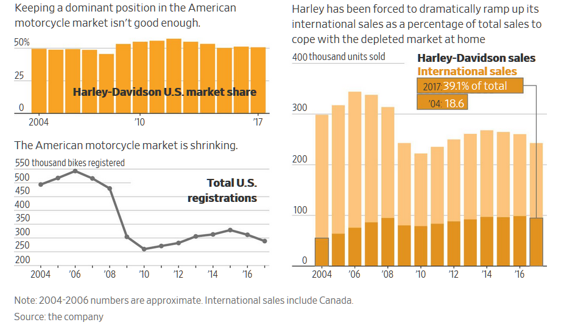
Harley-Davidson (2 of 2)
Source: The Wall Street Journal, June 26, 2018

Slide 34
Lecture Outline
Transportation Wrap-up
Case: Applichem
Intro to Facility Planning
Facility Design Framework & Models
Course Summary & Wrap-up

Slide 35
Data Aggregation
Customers located in close proximity are aggregated
Products are aggregated into groups
Why Aggregate?
  Cost of obtaining and processing data
  The size of the resulting model
  Accuracy of forecasts

Slide 36
Two types of models …
Locating a single facility
Locating multiple facilities

Slide 37
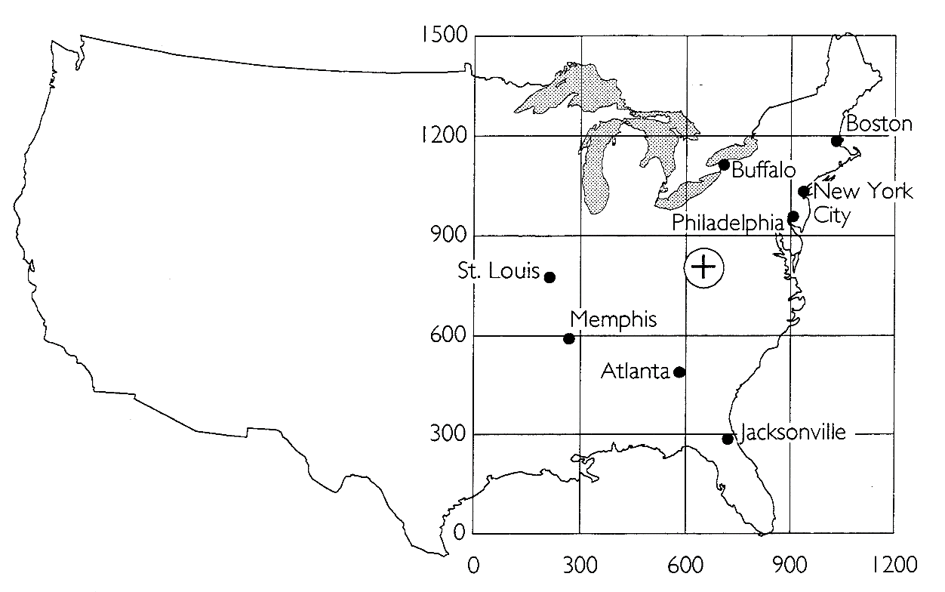
Example: Gravity Location Model
Small grocery store chain, currently rents a third party DC
Where to construct a company owned DC?
Store Locations | Transport rate ($/ton/mile) | Ship wt/Year (tons) | Coordinates
 |  |  | x_{n} | y_{n}
Buffalo | 0.90 | 500 | 700 | 1200
Memphis | 0.95 | 300 | 250 | 600
St. Louis | 0.85 | 700 | 225 | 825
Atlanta | 1.50 | 225 | 600 | 500
Boston | 1.50 | 150 | 1050 | 1200
Jacksonville | 1.50 | 250 | 800 | 300
Philadelphia | 1.50 | 175 | 925 | 975
New York | 1.50 | 300 | 1000 | 1080

Slide 38
Practical Use of COG Model
Location of truck maintenance terminals
Location of public facilities such as offices, police and, fire stations
Location of medical facilities
Location of most any facility where transportation cost (rather than inventory carrying cost and facility fixed cost) is the driving factor in location
As a suggestor of sites for further evaluation

Slide 39
Two types of models …
Locating a single facility
Locating multiple facilities

Slide 40
Demand Allocation Model with Fixed Costs
1675
Supplier A
400
Market 1
Supply ≤ KA
Requirements = D1
Good news ☺
We know it already.
So we are done ☺☺
Supplier B
Market 2
Supply ≤ KB
Requirements = D2
Supplier C
Market 3
Supply ≤ KC
Requirements = D3
.

Slide 41
Facility Planning:
Summary & Key Takeaways
The Strategic framework of facility design
Various models
  COG/Gravity location models
  Demand allocation/Optimization models
  Use of SOLVER, use of 0-1 variables
Applichem
  Issues in global distribution

Slide 42
Lecture Outline
Transportation Wrap-up
Case: Applichem
Intro to Facility Planning
Facility Design Framework & Models
Course Summary & Wrap-up

Slide 43
What has not Changed in SCM
Only
Total Cost
Matters
Tradeoffs
are
Forever
Some old
Responses
Still Work
Uncertainty
Will
Remain
Customers ultimately pay for inventory
Objective: lower customer acquisition cost by
information sharing and SC coordination
Example: info sharing, low complexity, excess capacity

Slide 44
What has not Changed in SCM
Only
Total Cost
Matters
Tradeoffs
are
Forever
Some old
Responses
Still Work
Uncertainty
Will
Remain
Can not have zero inventory and great service
Excess capacity can be appropriate if inventory is expensive
Tradeoffs are complicated, involves more than 2 factors
Optimization

Slide 45
What has not Changed in SCM
Only
Total Cost
Matters
Tradeoffs
are
Forever
Some old
Responses
Still Work
Uncertainty
Will
Remain
So “buffers” will still be needed
Buffers: inventory, excess capacity, etc.
Technology can reduce (but not eliminate!) uncertainty
Managing disruption risks are important

Slide 46
What has not Changed in SCM
Only
Total Cost
Matters
Tradeoffs
are
Forever
Some old
Responses
Still Work
Uncertainty
Will
Remain
Mass customization & postponement
Complexity reduction & standardization
Centralization reduces inventory
Golden rules of forecasting

Slide 47
Moral of the Story
Only
Total Cost
Matters
Tradeoffs
are
Forever
Some old
Responses
Still Work
Uncertainty
Will
Remain
Coordination and Cost saving opportunities of Technology are real. However, information has
NOT
replaced inventory.

Slide 48

Parting Thoughts
SCM helps you to understand businesses better
Big potential…
You need a balanced view: classics to contemporary
Yes! some parts are technical, but it is useful!!
  A software is only as good as your concept
In addition, it is the concept that lasts for ever
Class PPTs: any good?
Please remember to complete the
Course & Instructor Evaluation!

